Slide 1
Just Farming: An Environmental Justice Perspective on the Capacity of Grassroots Organizations to Support the Rights of Organic Farmers and Laborers
Becca Berkey, Ph.D.

Slide 2
Conceptual Framework
Notes:
EJ: Callewart’s call to consider broader socio-politico-economic processes and move beyond specific issue-based solutions and work/multidimensional exploration; Schlosberg’s expansion to recognition, capabilities, and participation (beyond just distribution)
Coalition-Building/Public Participation: authentic, innovative, and democratic leadership and engagement (building off of Schlosberg’s work)- trust building and true partnership reminiscent of recognition & capabilities
ABCD: build capacity to capitalize on a community’s assets- increased ability to do this within a broader, more systemic organization like NOFA
Examine the complexity, cross-sector realities, and long-term work of systemic change around farmworker justice in agricultural labor.

Slide 3
Research Question
How do various justice-related issues impact farmers and farmworkers on organic farms in the northeast, and how does involvement in a grassroots organization like the Northeast Organic Farming Association help them address these issues, if at all?
Notes:
Key assumptions- tie back into slide about organic products
How do various justice-related issues (including competition in the market, pay, housing, and health) impact farmers and farmworkers on organic farms in the northeast, and how does involvement in a grassroots organization like the Northeast Organic Farming Association help them address these issues, if at all?
Various subquestions emerged, a couple of which I will focus on for the purposes of today’s talk.

Slide 4
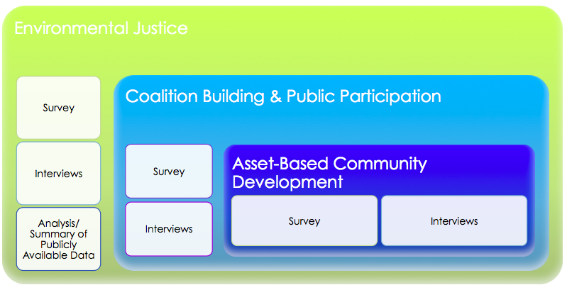
Conceptual Framework and Methodological Decisions
Notes:
Literature Review: Use publicly available data to describe trends in the presence of farmworkers in US and the northeast. Data Sources to include: USDOL National Agricultural Worker Survey, USDA Census of Agriculture, USDA National Agricultural Statistics Service, Inventory of Farmworkers (conducted/compiled by United Farm Workers & Bon Appetit)
EJ: Survey- provide information about who the workers are and nationally-normed justice issues surrounding farmworker treatment including pay, benefits, housing, training, etc., pressures felt by organic farmers, their priorities/commitments to organic farming including just/equitable treatment and obstacles to achieving those priorities. Interviews- understanding of justice/affect on practices and beliefs
Coalition-Building and Public Participation: Survey- Qs regarding membership in organizations & benefits of membership/assistance necessary, Interviews- how involvement affects understanding & practices re: farmworker justice
Asset-Based Community Development: Survey/Interviews- how can the understanding of justice within the network be informed by the network, what are the assets related to membership and inter-farm relations, questions about beneficial relationships, policy opinions

Slide 5
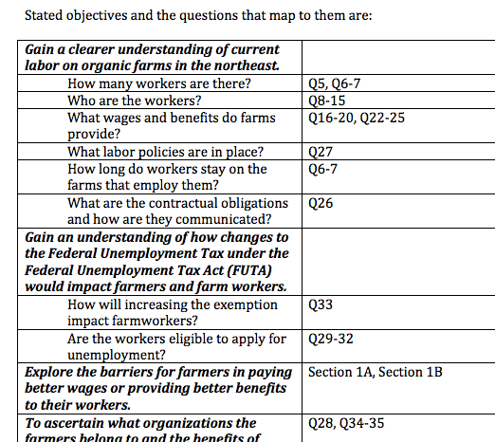
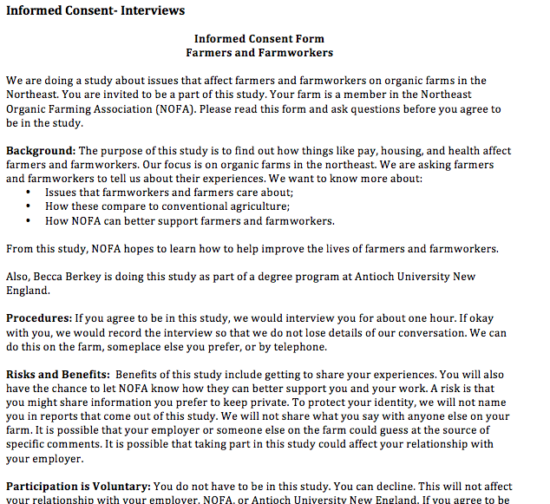
Methods
Survey
Analysis/summary of publicly available data
Phenomenological Interviews
3 farms: 4 farmers, 6 workers/3 members of the Interstate Council
Notes:
Survey
Distributed throughout the NOFA network
Alignment with other survey work
Descriptive analysis using Excel and SPSS
Analysis/summary of publicly available data to describe trends in the presence of farmworkers in US and the northeast.
Phenomenological Qualitative Interviews
Three farms chosen through purposeful sampling
NOFA Interstate Council Leadership
Coded, analyzed, and themed using a ‘bottom-up’ approach using Dedoose

Slide 6
Survey: Value Rankings

Slide 7
Survey: Supports for Implementing Values
Notes:
Based on responses rating their values as well as the supports they receive from group membership, it is clear that the main motivation for many organic farmers in the NOFA network relates to environmental sustainability and an understanding of the better health of organic production, and has less to do with drawing a premium within the market and/or solidarity with workers. The qualitative data collected from the open-ended response boxes provides information regarding a number of the challenges faced by organic farmers in the Northeast, chiefly related to lack of funding and profit, lack of experienced and willing workers, lack of time to spend both farming as well as completing the paperwork necessary (both governmental and otherwise) to grow and flourish.

Slide 8
Survey: Constraints in Implementing Values

Slide 9
Farmer and Worker Interviews: Emergent Themes
Notes:
Throughout the interviews across all three sites, comments on each of these themes in the four areas of justice, logistics, rationale for organic farming, and networks/coalitions emerged. Farmers and workers alike had a great deal to say about their conceptualizations of justice and how it is realized or not in their experience on the organic farm, and much of what the participants discussed, as evidenced in Chapter V, centered on the reasons that they farm organically or work on an organic farm in the first place. From their perspectives, the value that participants realized in living this lifestyle far outweighed the challenges they discussed, which were many and significant, including little to no pay, no health insurance, and the difficulty of the work itself.

Slide 10
Potential Implications for NOFA Members
Consider what can be done to ensure ongoing employment opportunities and training for workers
Build alliances with other employers that could utilize skills
Health/retirement benefit collective across network
Opportunity to build infrastructure that would connect the right workers with the right farms by identifying not only skill sets, but also values

Slide 11
Potential Implications for NOFA Members- cont’d
Opportunity for training and education on creating a just environment on the farm
Revisit and rearticulate your values, seek opportunities to align them with your environment, workers, and certification
Policy advocacy coupled with education

Slide 12
Thank you!
Acknowledgements
If you want to read
more:
www.northeastern.edu/nejrc
Questions?
Discussion

